Slide 1
Global Tech-Gadget Sales
Information Presentation and Visualization
Notes:
Hi everyone! Today we're going to show you how the global tech-gadget shop has been doing over the last 100 days. Instead of just looking at a boring list of numbers, we're going to use charts to show you the real story behind sales.

Slide 2
CHARTS
is a graphical representation of data. Visualizing data through charts helps to uncover patterns, trends, relationships, and structure in data.
Charts | Comparison | Time-series | Correlation
Bar Chart
Line Chart
Scatter Plot
Write your first clue
Bar Chart
Write your second clue
Line Chart
Write your third clue
Scatter Plot
Notes:
So, first what is a chart exactly? A chart is a graphical representation of data. Visualizing data through charts helps to uncover patterns, trends, relationships, and structure in data. So, here we use the 3 different type of chart. The Bar Chart, Line Chart, and Scatter Plot. These 3 chart have a different uses. Bar are good in comparison, while Line Chart are good in time-series data, and lastly the Scatter Plot, this is good for correlational data.

Slide 3
BAR CHART
01.
Ideal for comparing quantities and categorical data

Slide 4
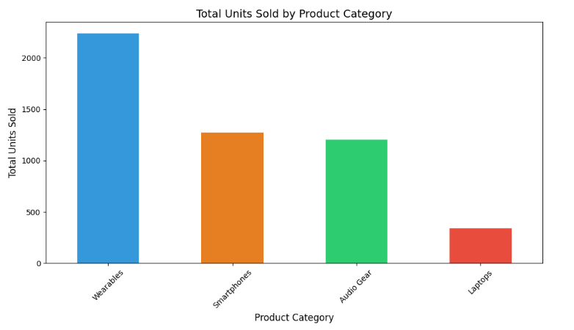
01.
BAR CHART
Ideal for comparing quantities and categorical data
Notes:
First is the Bar chart. This is good for comparing different groups. Here, compare the 4 variables which is the wearable, smartphones, audio gear, and laptops. If you look at the bars, Wearables (like watches) are the higher total unit sold, over 2,200. These tells that even though they aren't the most expensive, they are what most of customers are buying.

Slide 5
LINE CHART
02.
Showing trends over time
(time series data/sequence of data)

Slide 6
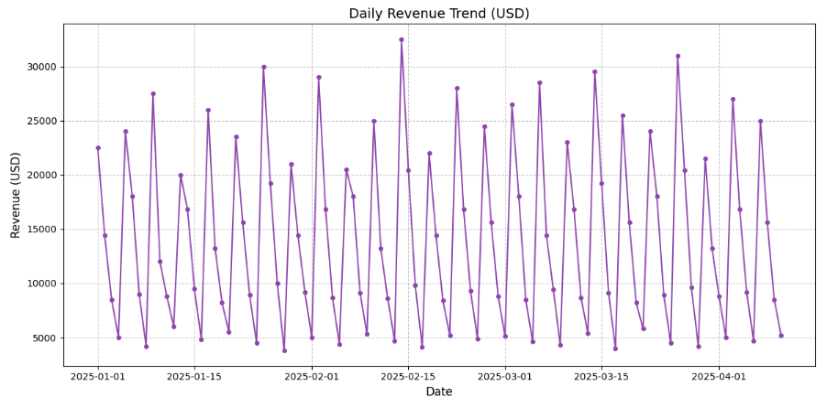
02.
LINE CHART
Showing trends over time
Notes:
Next, we have the Line Chart. This tracks how much revenue was made each day. As you can see, the line isn't smooth it jumps up and down quite a bit. These 'peaks' or high points show us exactly which days were the most successful. It helps us interpret that the money coming in isn't the same every day—it depends on what people were buying at that time.

Slide 7
SCATTER PLOT
03.
uses dots to represent values for two different numeric variables

Slide 8
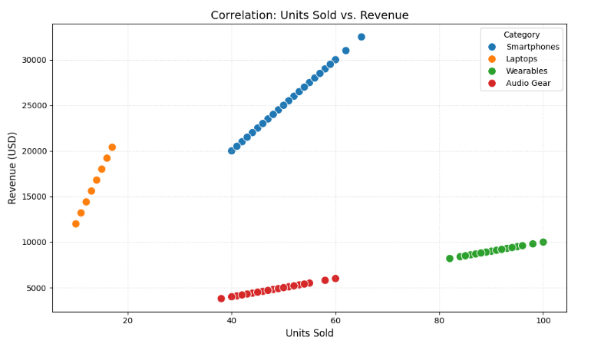
03.
SCATTER PLOT
uses dots to represent values for two different numeric variables
Notes:
Lastly, Scatter Plot, For this chart, we are looking at the connection between the number of items sold and the money made. We put Units Sold and Revenue. Each dot you see represents one single day from the data. What we noticed is that the dots naturally group together by category. For example, the Laptops are high up but to the left, which shows they make a lot of money even if we don't sell many. On the other hand, Wearables are far to the right, showing they sell in big numbers but for less money. This helps us interpret that the dataset has a mix of both high-priced and high-volume items.

Slide 9
Salamat sa buhay mo!!

